Slide 1
International Finance
Overview

Slide 2
Gold Standard
1876 – 1913
Values of currency set against precious metals
Each country set own conversion rate
Must maintain adequate reserves (Fort Knox) for redemption

Slide 3
Gold Standard
Gold standard implied fixed XR
Limited growth of money supply for any country
Need enough gold
WWI limited free movement of gold

Slide 4
1920s and 1930s
Some countries reverted to gold standard
Some abandoned
Some pegged to dollar or pound
Period of instability
International trade declined

Slide 5
Bretton Woods Agreement
International agreement in 1944
Fixed exchange rates
All currencies pegged to dollar
Dollar set at $35/ounce of gold
Intervention to prevent fluctuation of > 1%
Lasted until 1973

Slide 6
Floating Exchange Rates
By 1971, dollar had depreciated
Concerns about U.S. ability to convert dollars to gold
March 1973
U.S. allows dollar to float
Other major currencies float as well

Slide 7
Floating Exchange Rates
Determined by supply and demand
Factors affecting demand
Demand for nation’s product
Demand for nation’s stocks and bonds
Inflation expectations
Government stability

Slide 8
Floating Exchange Rates
Supply is determined by monetary policy of central bank
U.S. central bank is the Federal Reserve
Too much supply – inflation
Not enough supply - recession

Slide 9
Various Exchange Rate Systems

Slide 10
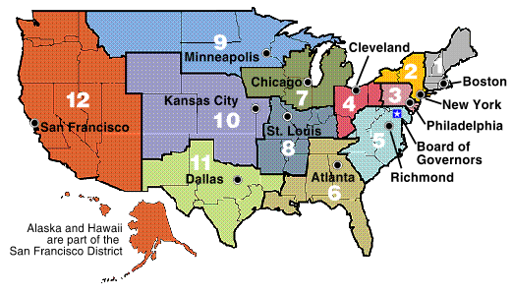
Federal Reserve
U.S. Central Bank
Established in 1913
12 federal reserve banks

Slide 11
Federal Reserve

Slide 12
Federal Reserve
Board of Governors
Seven members
Appointed by President and confirmed by congress
14-year term
Chairman’s term is four years

Slide 13
Federal Reserve
FOMC
Chief policymaking committee
All 7 governors
President of NY fed bank
Four other fed presidents
All fed presidents attend meetings
All votes are equal
Chairman has much influence

Slide 14
Federal Reserve
FOMC determines monetary policy
Supply of money
Purchase or sell fixed income assets
Influences short-term rates
Impacts XR

Slide 15
Federal Reserve
Mission
Maximum employment
Stable prices
Moderate long-term interest rates
Goals may conflict
XR is not explicit goal

Slide 16
Euro
Launched Jan. 4, 1999
11 original members
Belgium, Germany, Spain, France, Ireland, Italy, Luxembourg, Netherlands, Austria, Portugal, Finland
Greece, Cyprus, Estonia, Malta, Slovenia and Slovakia have joined since then

Slide 17
Euro
Advantages
Lower transaction costs
Less XR risk
Greater price transparency and price-based competition

Slide 18
Foreign Exchange Market
Spans the globe
Operates 24 hours/day
Largest financial market in the world
5 trillion dollars traded each day
Major exchanges
Singapore, Hong Kong, Tokyo, Bahrain, London, New York, San Francisco, Sydney

Slide 19
Foreign Exchange Market
10 AM
In Tokyo
Lunch
In Tokyo
Europe
opening
Asia
closing
Americas
open
London
closing
Afternoon
in America
6 pm
In NY
Tokyo
opens

