Slide 1
International Finance
International Trade and the Balance of Payments

Slide 2
Comparative Advantage
Specialization increases efficiency
  U.S. – technology
  China – labor productivity
  Bahamas – tourism
  Canada – wheat
  Colombia – coffee
  France – wine

Slide 3
Trade Occurs Because of Imperfect Markets
No Trade in Closed Markets
  Each country must produce and consume all its own goods
No Trade if Factors of Production Flow Freely Between Markets
  Every country has full and free access to everything in the world it needs

Slide 4
Balance of Payments
Summary of a country’s international transactions for a period (quarter)
  Businesses
  Individuals
  Government

Slide 5
Balance of Payments
Current Account
  Payments for merchandise and services
    Balance of trade
      Exports minus imports
  Factor income payments
  Transfer payments

Slide 6
Balance of Payments
Capital account
  Financial assets transferred across borders by people who relocate
  Direct foreign investment
  Portfolio investment

Slide 7
Examples of Current Account Transactions

Slide 8
Examples of Current Account Transactions

Slide 9
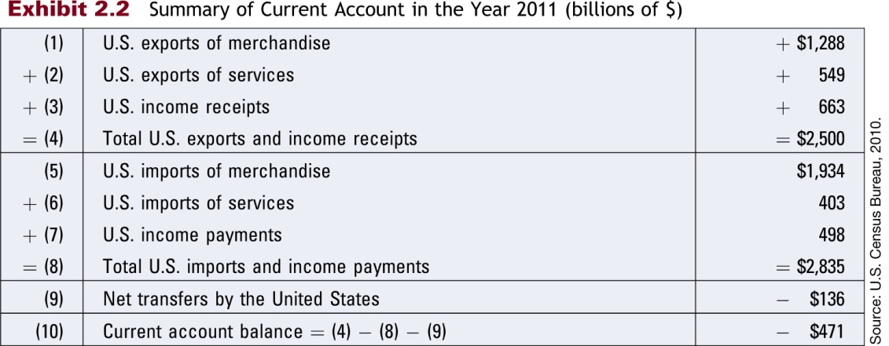
Summary of U.S. Current Account in 2011
(in billions of $)

Slide 10
U.S. Trading Partners - 2017
https://www.census.gov/foreign-trade/statistics/highlights/top/top1712yr.html
Note Balance of Payments 1960-2017 and U.S. Trade with Various Countries under Additional Materials in Class Notes

Slide 11
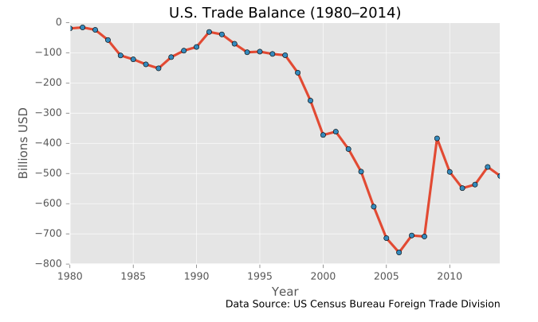
U.S. Balance of Trade Over Time

Slide 12
Value of the Dollar
Strong dollar
  Makes U.S.-made goods more expensive abroad
  Makes foreign-made goods less expensive here
  Increases imports
  Decreases exports

Slide 13
Value of the Dollar
Weak dollar
  Makes U.S.-made goods less expensive abroad
  Makes foreign-made goods more expensive here
  Increases exports
  Decreases imports

Slide 14
International Trade
Events that Increased International Trade
  Removal of Berlin Wall (1989)
  Single European Act (1987)
  NAFTA (1993)
  Euro (1999)
  Expansion of European Union (2004)

Slide 15
International Trade
Factors affecting international trade flows
  Inflation
  National income
  Exchange rates
  Government policies

Slide 16
Government Policies that Affect Trade
Subsidies for exporters
Restrictions on imports
  Tariffs
Lack of restrictions on piracy

Slide 17
Direct Foreign Investment
Investment in real assets in foreign countries
  Allows firms to reach additional consumers
  Access to low-cost labor
  Some MNCs have over 50% of assets in foreign countries

Slide 18
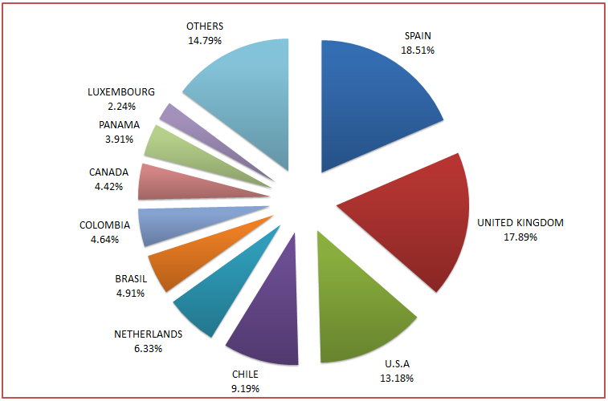
Distribution of Global DFI in 2015

