Slide 1
International Finance
Forecasting Exchange Rates

Slide 2
Why Firms Forecast XRs
Hedging decisions
  Hedging payables and receivables
Short-term financing decisions
  Which currency to borrow in
    Low rate, weakening currency

Slide 3
Why Firms Forecast XRs
Short-term investment decisions
  Which currency to park money in
    High rate, strengthening currency

Slide 4
Why Firms Forecast XRs
Capital budgeting decisions
  Analysis includes currency conversions for future cash flows
    Must assume an XR

Slide 5
Why Firms Forecast XRs
Earnings assessments
  Should foreign subsidiary remit earnings to parent, or reinvest in foreign country?
    Remit if foreign currency is expected to depreciate

Slide 6
Why Firms Forecast XRs
Long-term financing decisions
  Currency of coupon payments for bonds
  Dual currency bonds
    Coupon payments in different currency from face value

Slide 7
Forecasting Techniques
Technical Forecasting
  Use of historical XR data
  Looks for trends
  Tends to focus on near-term future
  Not very precise
  Patterns may disappear

Slide 8
Forecasting Techniques
Fundamental Forecasting
  Based on relationships between economic variables and XRs
    Inflation rates
    Interest rates
    Income levels
    Government controls

Slide 9
Forecasting Techniques
Fundamental Forecasting
  Forecasters study fundamentals of economy to predict economic trends
  Plot how past econ events impacted XRs
  Use linear regression to forecast

Slide 10
Forecasting Techniques
Purchasing Power Parity
(1 + Π_{D}) = S_{t+1} = 1+ΔS^{D/F}
(1 + Π_{F}) S_{t}
Inflation expectations can come from TIPS vs. T-notes

Slide 11
Forecasting Techniques
Forward Rates
  Market-based forecast
  Must account for bid-ask spread (can be wide)

Slide 12
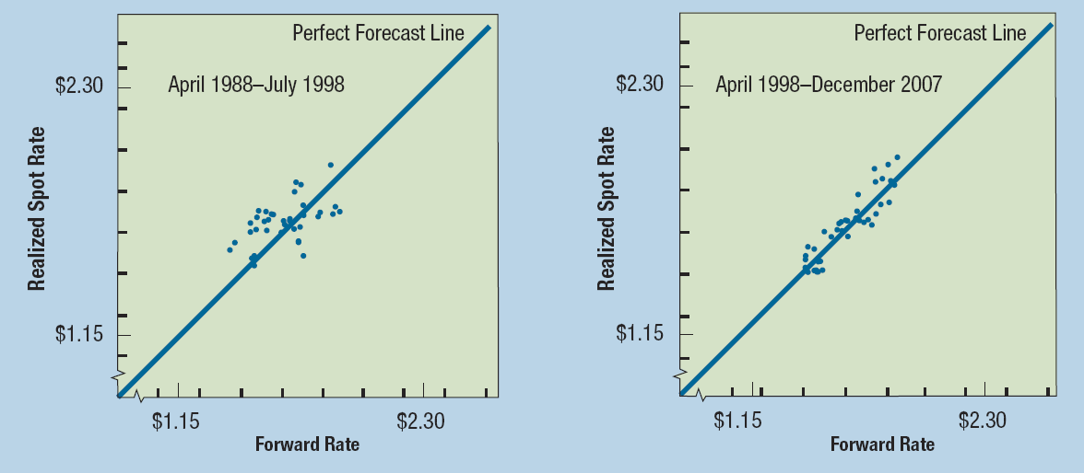
Forecasting Techniques
Example: $/£

Slide 13
Forecasting Techniques
Today’s Spot Rate
  Expectations already built into spot rate
  Best for short-term forecasting
  Relies on notion of market efficiency

Slide 14
Forecasting Techniques with Mexican Peso

Slide 15
Forecast Error
Always will have some error
Potential error is larger for
  More volatile currencies
  Longer forecast horizon

Slide 16
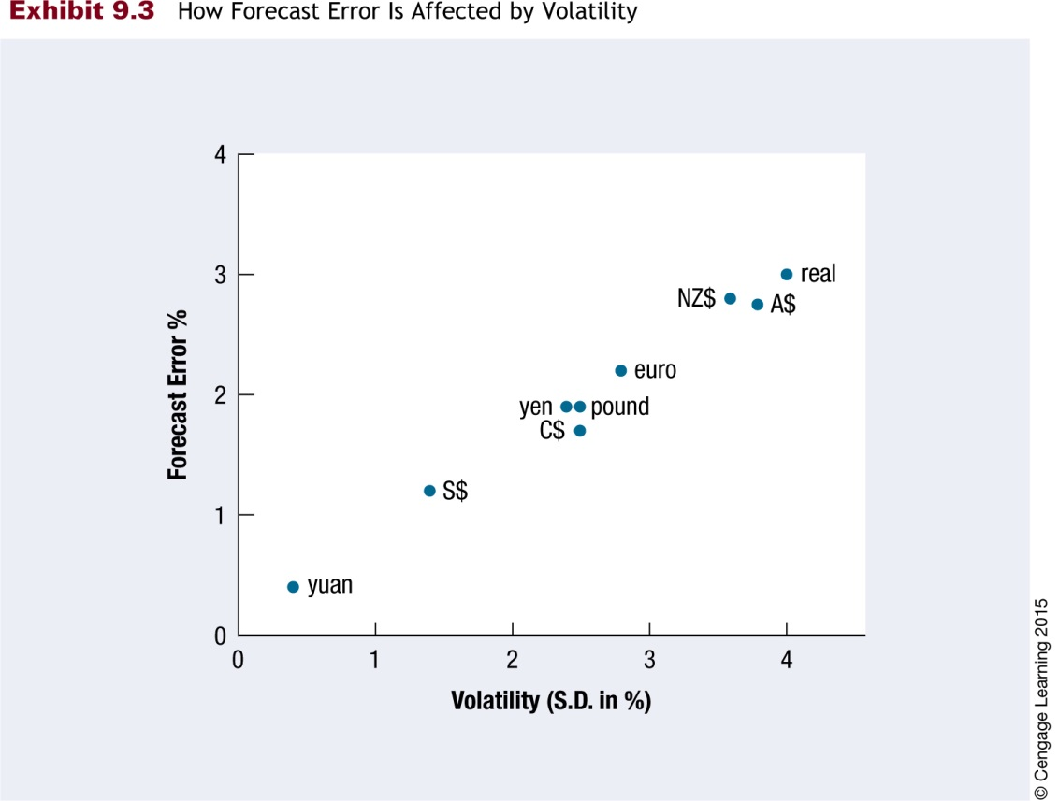
How Forecast Error is Affected by Volatility

Slide 17
Forecast Error
Forecast error can have severe consequences for MNC
  Can turn positive NPV project into negative NPV project
  MNC may choose to hedge

Slide 18
Forecast Error
Measuring forecast error
  As percentage of realized value
Difference between
  Forecasted & Realized
  Error = Value Value
  Realized Value

Slide 19
Forecast Error Example
British Pound Mexican Peso
1.50 - 1.35 = 10% .12 - .10 =20%
  1.50 .10
 | Forecasted Value | Realized Value
British Pound | $1.35 | $1.50
Mexican Peso | $.12 | $.10

Slide 20
Types of Forecast Errors
Inaccurate but unbiased
  Low r²
  Large but random forecast errors
Biased
  Predictable forecast errors

Slide 21
Forecast Error Example

Slide 22
Forecast Error Example

